Slide 1
Securing Medical Data Storage with PQC
Stefan-Nikola & Youp Klijnman

Slide 2

Project Context
Sensitive Data
RSA and ECC - future quantum attacks
store-now, decrypt-later risk
PQC
Maxima Medical Center

Slide 3


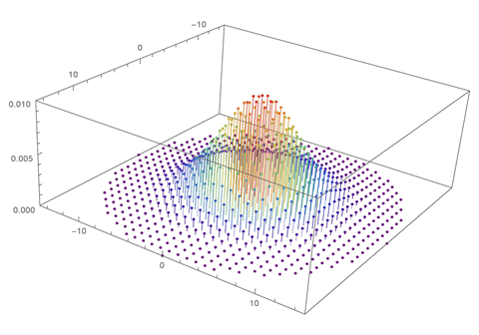

Ring-lwe algorithm
What is Ring-LWE
  Lattice-based cryptographic construction
  Secure against normal and quantum attacks
  Operates over polynomial rings instead of matrices
  $R_{q}=\frac{ℤ_{q\left[x\right]}}{\left(x^{n}+ 1\right)}$
  Cryptographic keys and messages are represented as polynomials
  Security relies on the difficulty of solving noisy polynomial equations

Slide 4
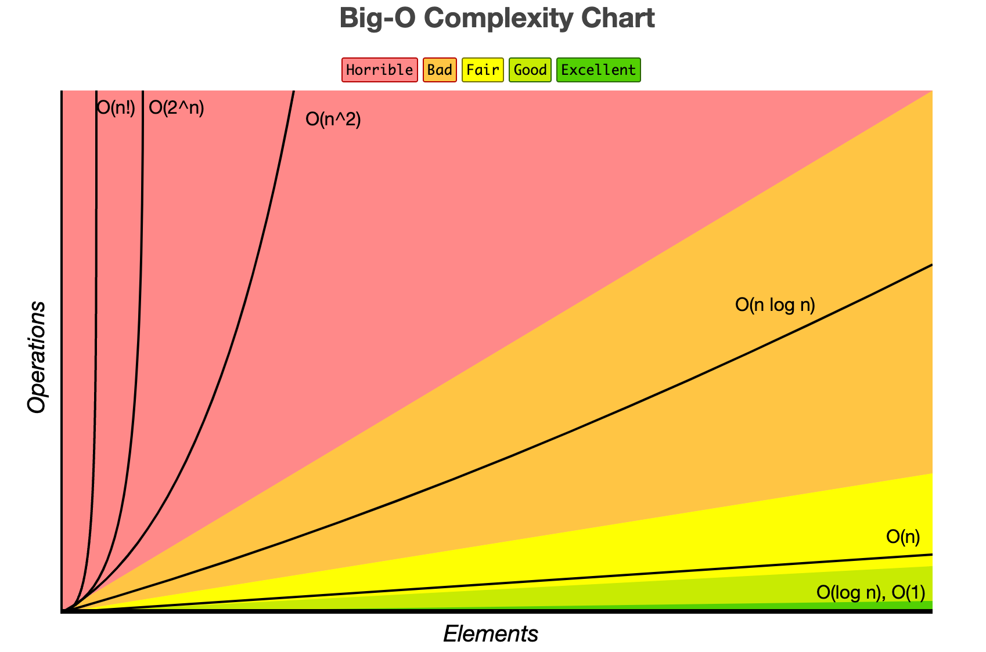

Bottleneck of ring-lwe
Problem
  polynomial multiplication
  Computainal heavy
  Time complexity: 0($n^{2}\text{)}$
  Runtime increases quadratically
Notes:
Problem
Ring-LWE relies heavily on polynomial multiplication
Each encryption and decryption requires multiple multiplications
Time complexity: 0($n^{2}\text{)}$
Runtime increases quadratically with polynomial size
Becomes impractical for realistic post-quantum security parameters

Slide 5

Number Theoretic Transform (NTT)
What is NTT
  Number Theoretic Transform (NTT) is an FFT-like algorithm that works over finite fields.
  It enables fast polynomial multiplication, which is the main operation in Ring-LWE
  Used in many post-quantum cryptographic standards
  NTT reduces normal Ring-LWE complexity to $O (n log{n}$)
  Improves speed without weakening security

Slide 6

Implementation
What was implemented
  Two variants of Ring-LWE polynomial multiplication in Python:
    Baseline: normal polynomial multiplication 0($n^{2}\text{)}$
    Optimized: NTT-based multiplication $O (n log{n}$)
  Benchmarking the core operation that dominates performance
  Focus: performance impact of NTT on realistic polynomial sizes
Implementation Choices
  Language: Python
  Input: randomly generated polynomials representing Ring-LWE operands
  Parameters: identical for both implementations to ensure fair comparison
  Multiple runs to account for variability
  Polynomial sizes: scaled to reflect realistic post-quantum security

Slide 7
Implementation
How it works
  Generate random polynomials A, B
  Multiply using either:
    Normal multiplication
    NTT-optimized multiplication
  Measure execution time and compare results
  Repeat for increasing polynomial sizes
  Evaluate speedup and memory usage

Slide 8
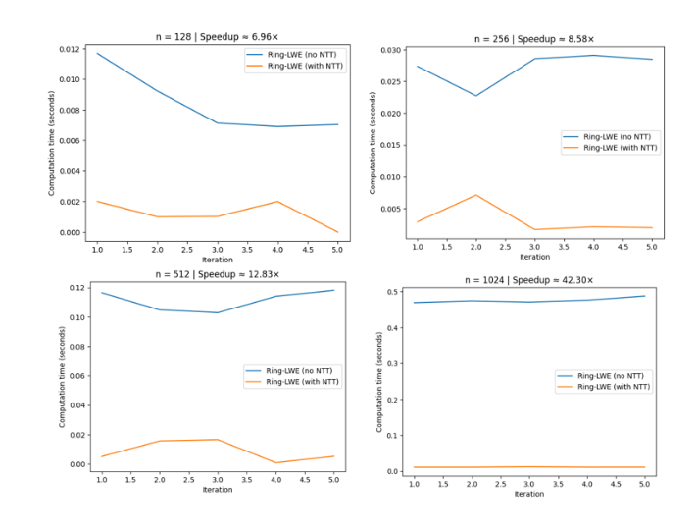
Experimental Results
Higher n = high security, more computation
Small n = low security, fast
As tests become more secure, the computation becomes slower and slower

Slide 9
Conclusion
Ring-LWE provides strong post-quantum security for hospital data
Normal implementation is too slow for large-scale or time-sensitive applications
NTT optimization significantly improves performance without compromising security
NTT-optimized Ring-LWE is a practical candidate for protecting sensitive medical records
Normal Ring-LWE
Slow
NTT-optimized Ring-LWE
Fast & Secure

Slide 10
Future improvements
Performance Optimizations
  Use highly optimized, constant-time NTT libraries
Hybrid Encryption
  PQC for key encapsulation
  Symmetric encryption for large medical files
  Balances security and efficiency

Slide 11
Thank you!

